Slide 1


Slide 2


HOTELREVAI AI DRIVEN REVENUE ANALYSIS FOR HOTELS
Contents
1. Introduction
Implementation Steps
2. Visualization Strategies
Key Aspects of Power BI Visualization & Dashboards
Steps to Create a Dashboard
Common Power BI Visualizations
3. Story Telling
HOTEL BOOKING PERFORMANCE OVERVIEW
Hotel Comparison
Yearly Performance
Revenue Trends
Booking Count by Distribution Channel
Cancellation Analysis
Booking Count by Customer Typ

Slide 3
HOTELREVAI AI DRIVEN REVENUE ANALYSIS FOR HOTELS
Contents:
4.0 AI-Driven Capabilities
Smart Visual
5.0 Conclusion
Final Key Takeaways

Slide 4

HOTELREVAI AI DRIVEN REVENUE ANALYSIS FOR HOTELS
Introduction:
The HotelRevAI project in Power BI integrates advanced visualization, data-driven storytelling, and artificial intelligence to transform complex hospitality data into actionable revenue intelligence.
By automating analysis that previously took days, the project enables hotels to achieve significant performance gains, including reported revenue increases of up to 10-17% and occupancy boosts of 10%.
Key Components & Features:
1.AI-Driven Insights
2. Interactive Visualizations
3. Data Storytelling
4. Key Metrics Tracked
5. AI-Powered Q&A

Slide 5
HOTELREVAI AI DRIVEN REVENUE ANALYSIS FOR HOTELS
Implementation Steps:
Data Preparation: Import and clean hotel booking, guest, and meal data.
Data Modeling: Create relationships between tables (bookings, hotels, rooms) for accurate reporting.
DAX Calculations: Develop formulas for KPIs like revenue growth, cancellation rates, and week-on-week changes.
Dashboard Design: Create intuitive, interactive dashboards for stakeholders.
AI Feature Integration: Incorporate Key Influencers visual, Q&A, and forecasting capabilities in Power BI.

Slide 6
HOTELREVAI AI DRIVEN REVENUE ANALYSIS FOR HOTELS
Visualization Strategies:
Power BI dashboards are single-page, interactive "canvases" in the Power BI Service that visualize key performance indicators (KPIs) and data highlights from multiple reports using tiles. They allow for real-time monitoring, data exploration via drill-downs, and sharing insights, with popular visualizations including bar charts, line charts, maps, and KPIs.
Key Aspects of Power BI Visualization & Dashboards:
Dashboards vs. Reports: Dashboards are exclusive to the Power BI Service (single page,,,high-level), while reports are created in Power BI Desktop (multiple pages, detailed).
Tiles: Visuals on a dashboard are called "tiles," pinned from one or more reports.
Key Visualizations:
KPI Cards: Display critical, single-number metrics prominently.
Bar/Column Charts: Compare categories (e.g., sales by product).
Line Charts: Show trends over time.
Maps: Visualize geographical data.
Funnel Charts: Illustrate business processes like sales pipelines.

Slide 7
HOTELREVAI AI DRIVEN REVENUE ANALYSIS FOR HOTELS
Steps to Create a Dashboard:
Build a Report: Create visuals in Power BI Desktop and publish to the Service.
Pin Visuals: Pin report visuals as tiles to a new or existing dashboard.
Arrange and Resize: Organize tiles for a clear, logical layout.
Set Alerts: Configure alerts on key metrics to track changes.
Common Power BI Visualizations:
Comparison Visuals: Bar and column charts are standard for comparing values across categories, while line charts are best for showing trends over time.
Part-to-Whole Visuals: Pie and donut charts show how individual parts contribute to a total, and treemaps are excellent for large amounts of hierarchical data.
KPIs and Cards: Card visuals display a single important number prominently, while KPI visuals communicate progress toward a specific goal.

Slide 8
HOTELREVAI AI DRIVEN REVENUE ANALYSIS FOR HOTELS
Story Telling:
HotelRevAI moves beyond static reporting by "connecting the dots" to explain why data is changing.
The Narrative Arc: Dashboards are structured to tell a "story of growth," identifying where revenue is being lost and highlighting the most profitable guest segments.
Contextual Insight: Instead of just showing historical data, the storytelling approach provides a hypothesis for future implications, helping stakeholders understand where current decisions are leading them.
Departmental Tailoring: Reports are adapted for different audiences; for example, showing F&B Performance Insights (cover counts, average per customer) for restaurant managers while focusing on Channel Performance for marketing teams.

Slide 9
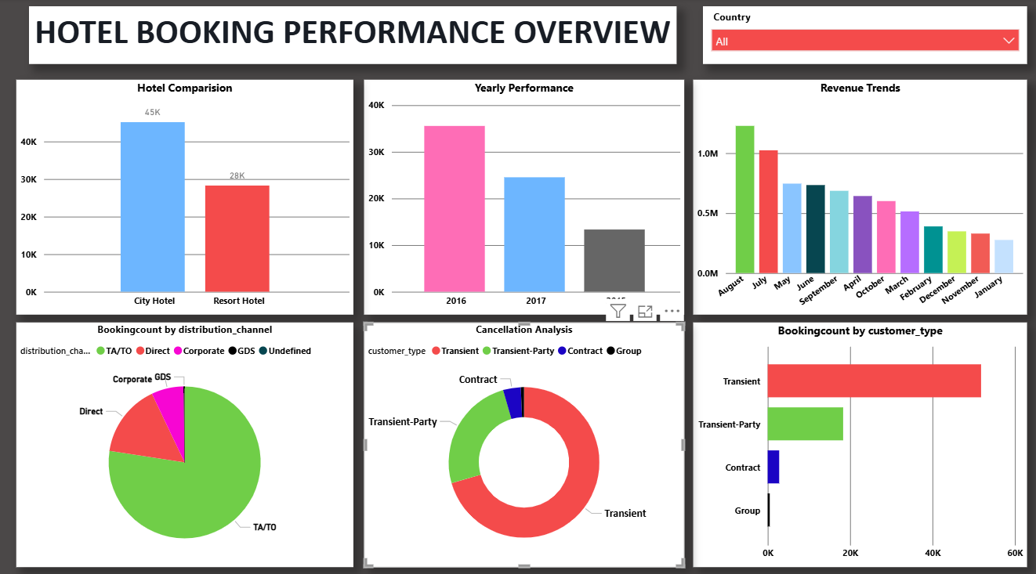
HOTELREVAI AI DRIVEN REVENUE ANALYSIS FOR HOTELS
HOTEL BOOKING PERFORMANCE OVERVIEW:

Slide 10
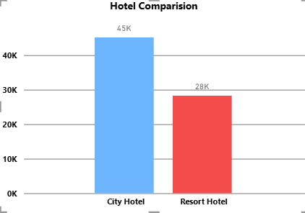
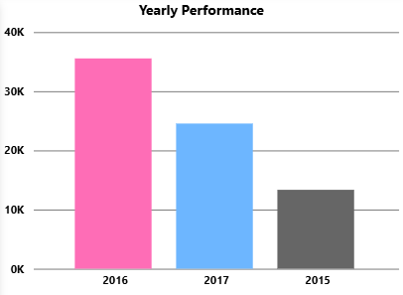
HOTELREVAI AI DRIVEN REVENUE ANALYSIS FOR HOTELS
Hotel Comparison:
The Data: City Hotels account for roughly 45K bookings,
while Resort Hotels sit at 28K.
The Story: The portfolio leans heavily toward urban destinations.
City Hotels are the primary driver of booking volume,
pulling in about 60% more guests than the Resort properties.
Yearly Performance:
The Data: 2016 was the peak year with nearly 36K bookings.
2017 saw a drop to around 25K, and 2015 had the lowest volume
at roughly 14K.
The Story: The hotel experienced a massive growth spurt from
2015 to 2016, more than doubling its bookings. However, it
struggled to maintain that momentum into 2017, experiencing a
noticeable cooling-off period.

Slide 11
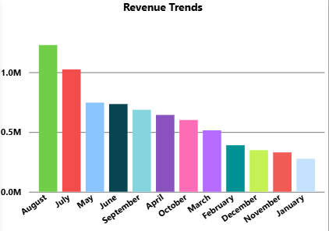
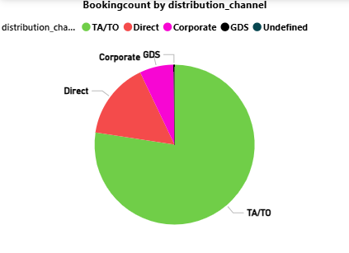
HOTELREVAI AI DRIVEN REVENUE ANALYSIS FOR HOTELS
Revenue Trends:
The Data: Revenue is highest in August (~1.2M) and July (~1.0M),
steadily tapering off toward the winter months, with November,
December, and January bringing in the least revenue.
The Story: The business is highly seasonal. Summer vacations are
the clear driver of the hotel's financial success, representing the
peak season, while the winter months represent a significant dry spell.
Booking Count by Distribution Channel:
The Data: TA/TO (Travel Agents and Tour Operators) take up the vast
majority of the pie, followed by Direct bookings, and a tiny sliver of
Corporate bookings.
The Story: The hotel is heavily reliant on third-party agencies to fill its rooms.
While this guarantees volume, it likely comes at the cost of high commission
fees eating into profit margins.

Slide 12
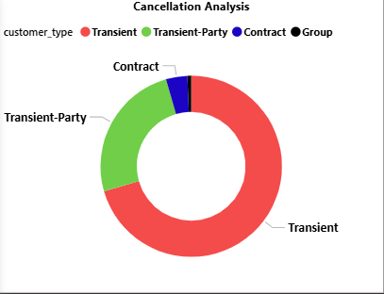
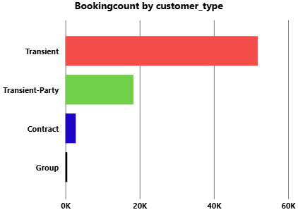
HOTELREVAI AI DRIVEN REVENUE ANALYSIS FOR HOTELS
Cancellation Analysis:
The Data: Transient guests make up the largest chunk of cancellations, followed
by Transient-Party. Contract and Group cancellations are negligible.
The Story: Individual travelers making short-term stays (Transient) are the most
flaky when it comes to keeping their reservations.
Booking Count by Customer Type:
The Data: Transient guests are the overwhelming majority of the customer
base (over 50K bookings), with Transient-Party coming in second (~20K).
The Story: This chart adds critical context to the Cancellation Analysis. Transient
guests have the most cancellations simply because they represent the hotel's core
demographic. The hotel caters primarily to everyday individual travelers rather than
large corporate groups or long-term contracts.

Slide 13
HOTELREVAI AI DRIVEN REVENUE ANALYSIS FOR HOTELS
AI-Driven Capabilities:
AI features within Power BI and integrated models (like LangChain or regression) provide the "predictive fuel" for the project.
Demand Forecasting: Machine learning models analyze 100+ data sources—including local events, weather, and competitor movements—to predict occupancy 30 days into the future.
Dynamic Pricing Engine: AI automatically suggests or executes real-time rate adjustments based on detected market shifts, such as a sudden event announcement.
Smart Visuals:
Decomposition Trees: Automatically identify the primary factors (e.g., specific room types or regions) driving revenue shifts.
Anomaly Detection: Proactively flags unusual spikes in cancellations or drops in booking pace.
Smart Narrative: Generates automated text summaries of the most important dashboard insights for executive review.
Hyper-Segmentation: AI analyzes guest behavior (e.g., spa usage, dining habits) to create micro-segments, enabling personalized upselling that can increase ancillary revenue by 23%.

Slide 14
HOTELREVAI AI DRIVEN REVENUE ANALYSIS FOR HOTELS
Conclusion:
The HotelRevAI project concludes that the marriage of AI-driven forecasting and Power BI storytelling is no longer a luxury, but a necessity for modern hospitality. By shifting from reactive reporting to proactive revenue management, hotels can move the needle from simple data collection to high-impact financial growth.
Final Key Takeaways:
Efficiency Gains: Automating complex revenue calculations saves management hours, allowing for faster decision-making in a volatile market.
Revenue Optimization: The project proves that AI-backed pricing and demand forecasting can directly increase RevPAR by 10-17% by capturing demand that manual systems miss.
Actionable Intelligence: Through Smart Narratives and Decomposition Trees, the dashboard transforms "cold numbers" into a clear strategic roadmap, identifying exactly which booking channels or guest segments require attention.
Future Readiness: By integrating external data (weather, events, and competitor rates), the project ensures hotels are not just looking in the rearview mirror but are prepared for upcoming market shifts.
Ultimately, HotelRevAI demonstrates that when data visualization is used to tell a story, it bridges the gap between data science and operational excellence, ensuring every room is sold at the optimal price at the optimal time.

